Slide 1
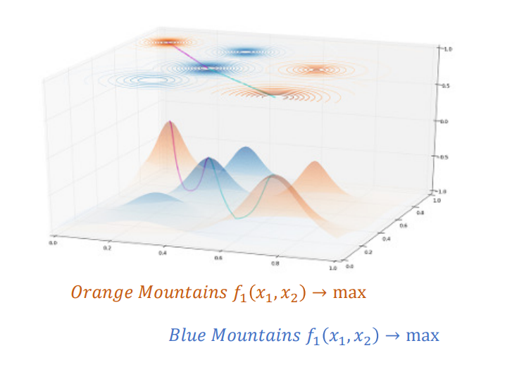
Unit: Efficiency and level sets

Slide 2

Pareto optimization: All Definitions
$$≺$$
$$≤ :weak componentwise order. In every component smaller or equal$$
Matthias Ehrgott: Multicriteria Optimization: Springer 2005
Open Access:
Emmerich, M. T., & Deutz, A. H. (2018). A tutorial on multiobjective optimization:
fundamentals and evolutionary methods. Natural computing, 17(3), 585-609.
https://link.springer.com/article/10.1007/s11047-018-9685-y

Slide 3
Learning Goals
Correct definition related to multiobjective optimization: Efficient set, Pareto front, weak efficient set, strict efficient set, strictly non-dominated set, weakly non-dominated set.
Shapes of Pareto fronts: Classification convex/concave and invariances
Identification of efficient sets based on contour plots and level sets
Pareto front =
Set of interesting solutions
x2
f2
Image
under f
f
Search space
(decision space)
Objective space
(solution space)
x1
f1
x3

Slide 4
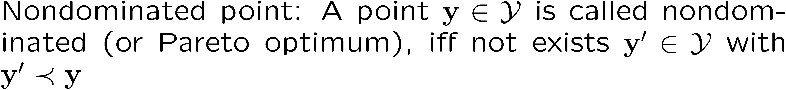

Pareto optimization: All Definitions

Slide 5
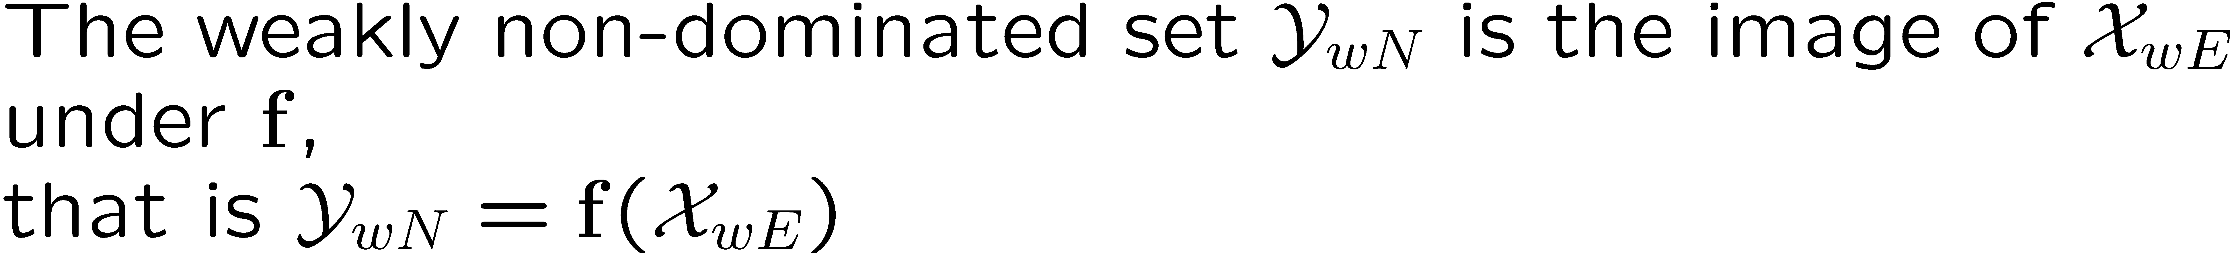
Weakly efficient and nondominated set

Slide 6
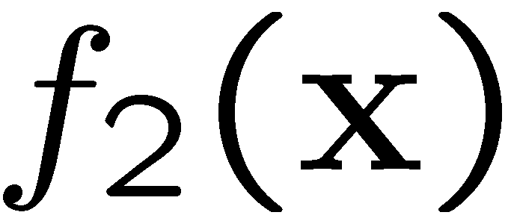

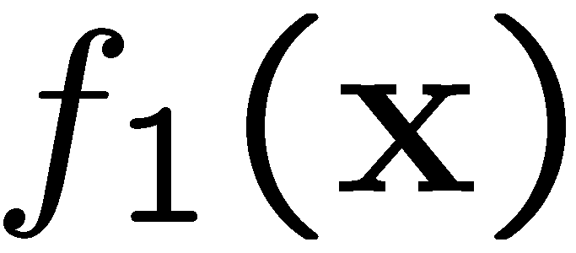

Weak non-domination vs. non-domination

Slide 7

Convex and concave PF: precise definition
… convex: monotonically decreasing, slope is increasing
… concave: “ “ is decreasing (gets more negative)

Slide 8
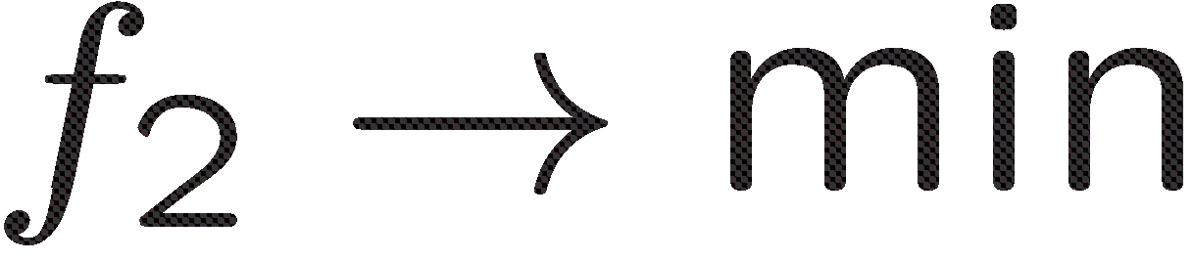
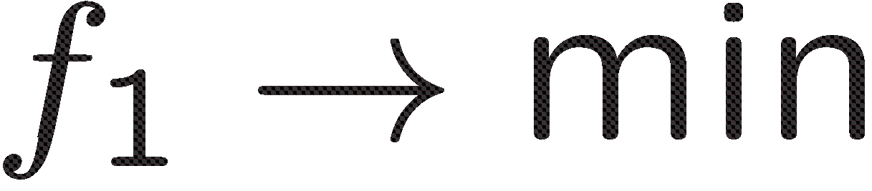
Different shapes of Pareto fronts
As well as …
Either or conflict

Slide 9

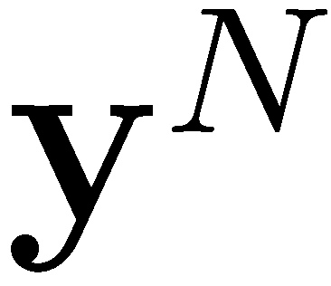
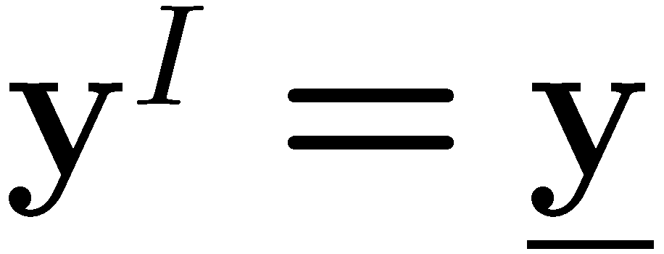
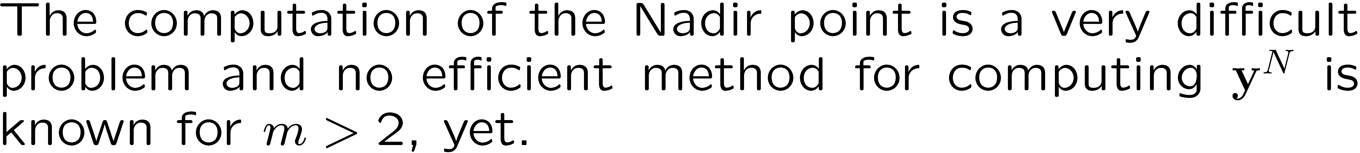
Special points
f2
f1

Slide 10
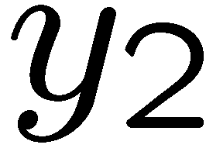
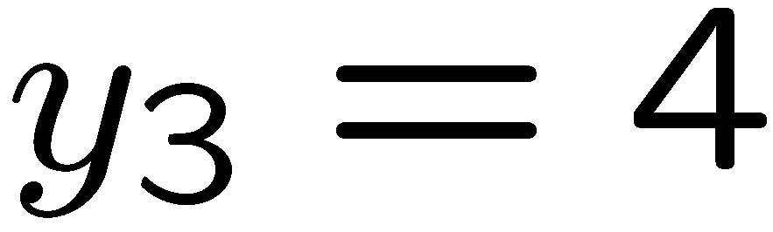
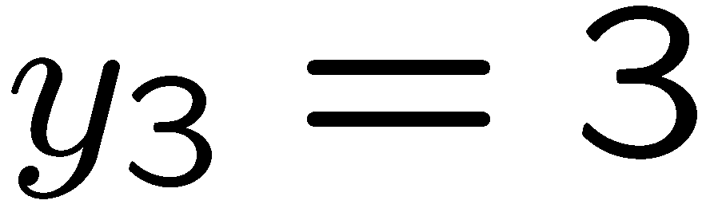

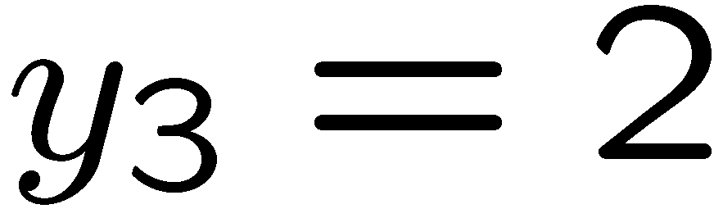
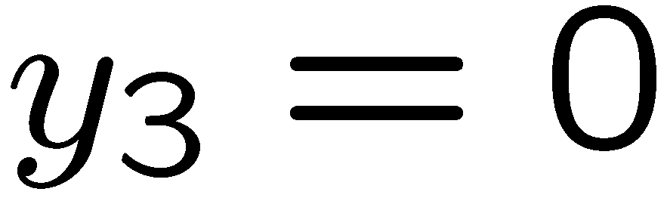

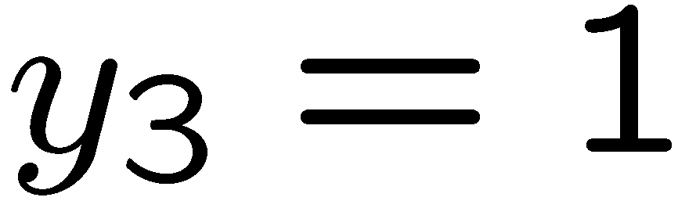

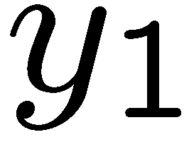
3-D Attainment surface, dominated space

Slide 11
3-D Attainment Surface, Continuous

Slide 12
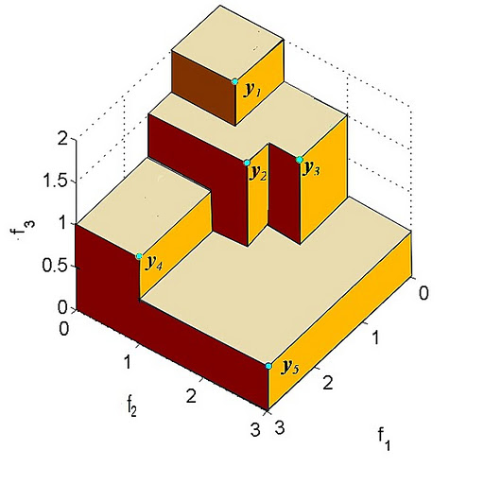
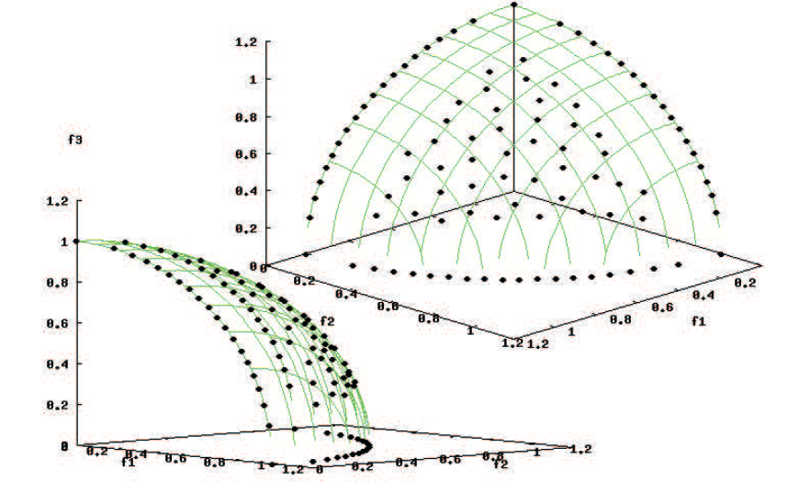
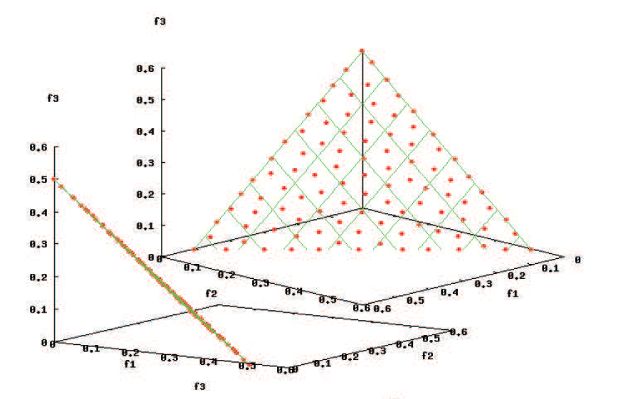
Pareto front in three dimensons
3-D continuous Pareto fronts and
approximations to them with 70 points.
Visualization of finite PF with 5 points.
Here maximization is considered: Dominance cones are the negative orthants

Slide 13
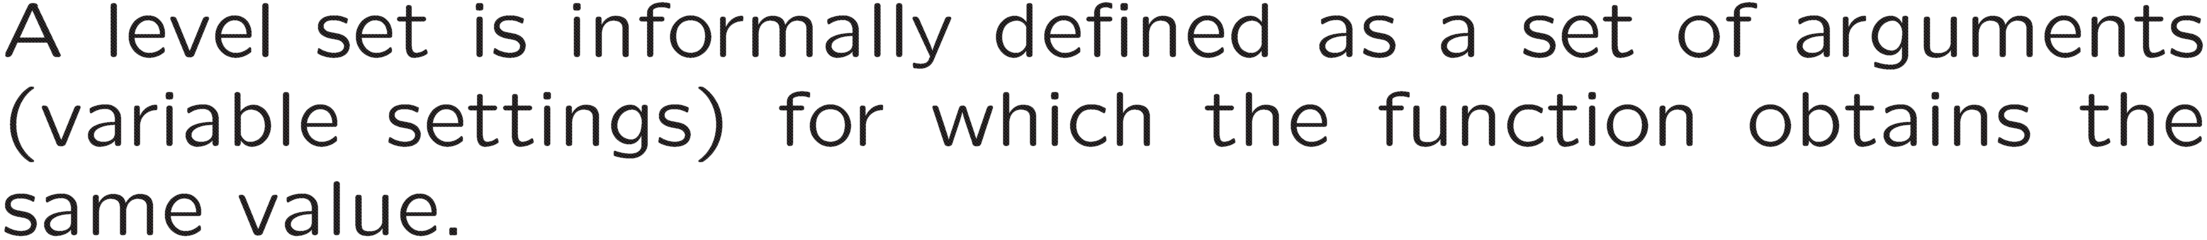
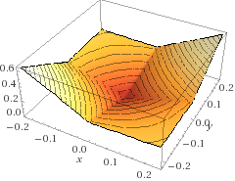
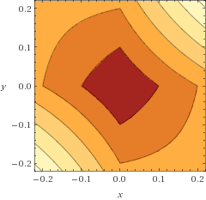
Optima seeking using contour plots

Slide 14
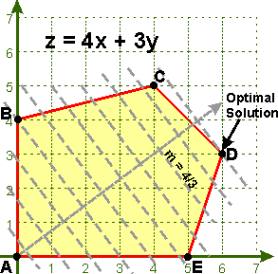
Finding efficient set using level sets (contours): Single objective optimization, linear case
Infeasible subspace
feasible
space
Level curve of f = contour line
of equal height (f = const)

Slide 15
Hillclimbing in Multiobjective Landscapes

Slide 16
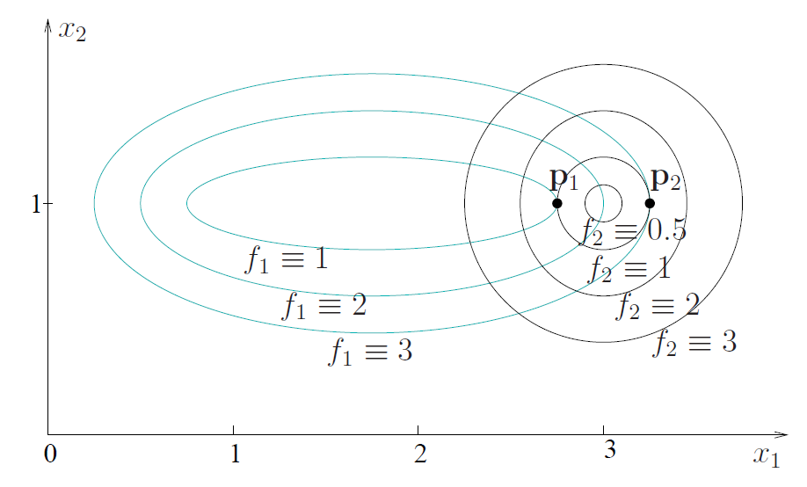
Finding efficient points using contour plots
Tangential points of contours are often efficient point

Slide 17
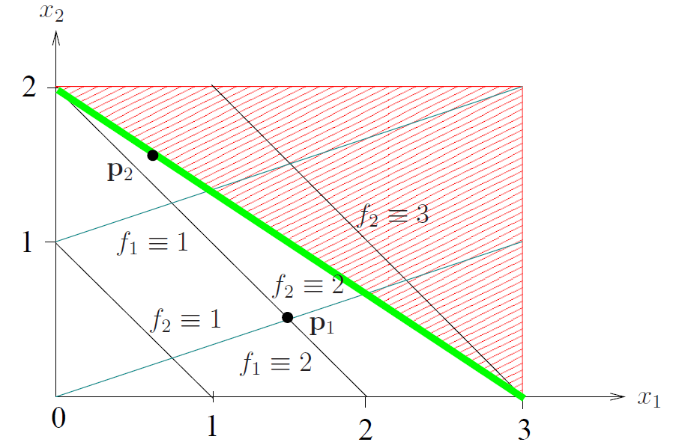
Finding the efficient set in IR²: Example!!!!!
=c
Infeasible region
Efficient set

Slide 18
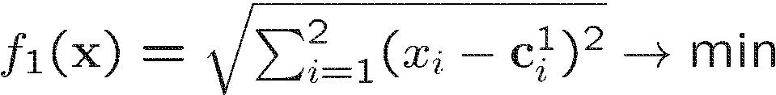
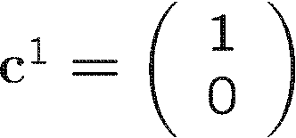
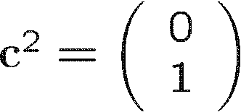
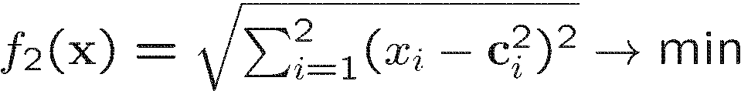
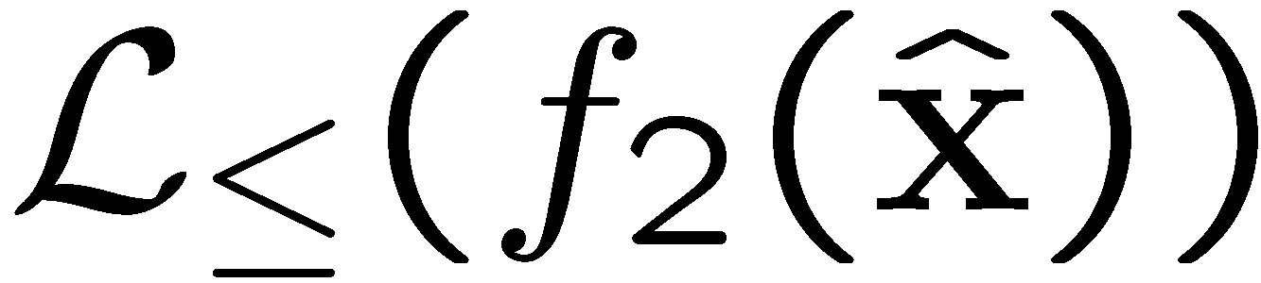
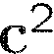






Finding the efficient set in IR²: Example
Facility location problems

Slide 19
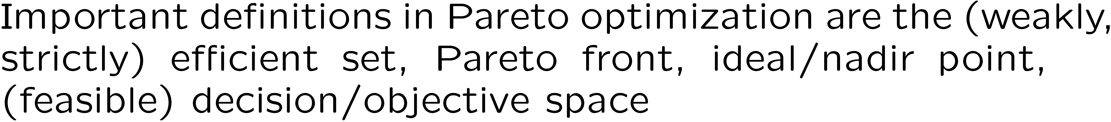
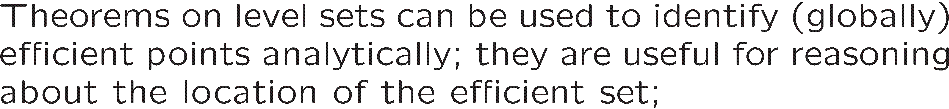
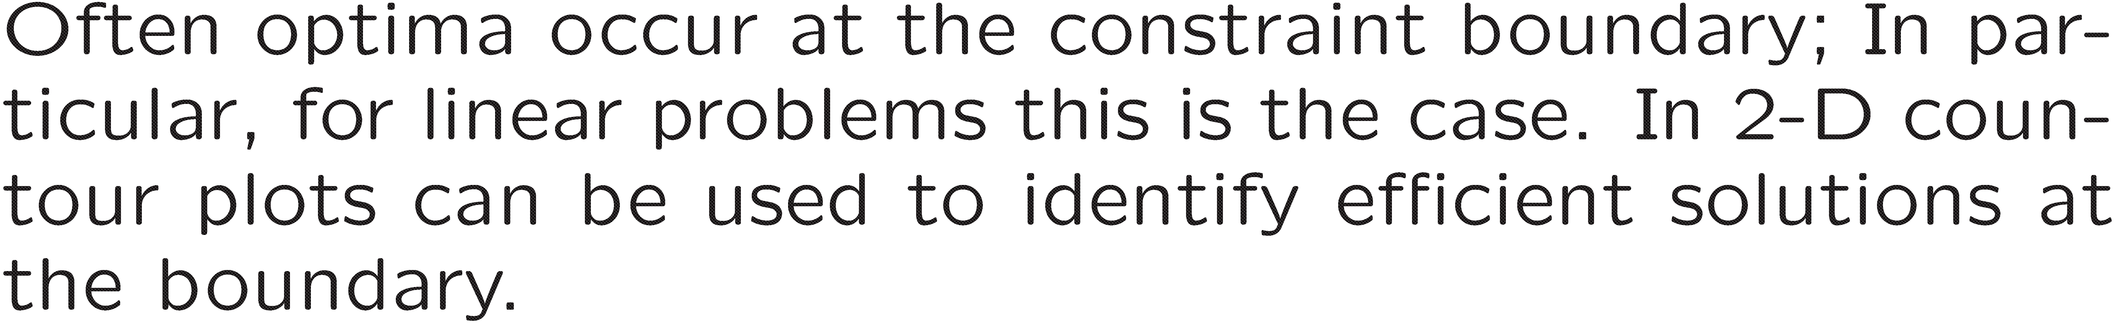
Take home messages

Slide 20
Additional Material

Slide 21
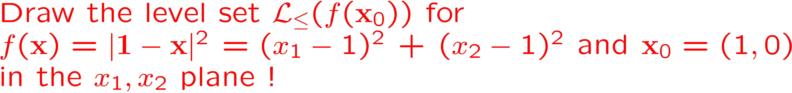
Level sets and curves

Slide 22
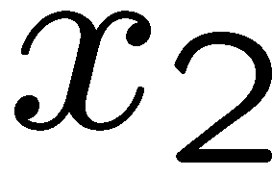

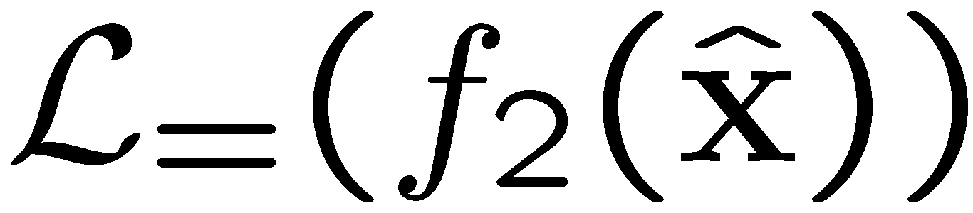

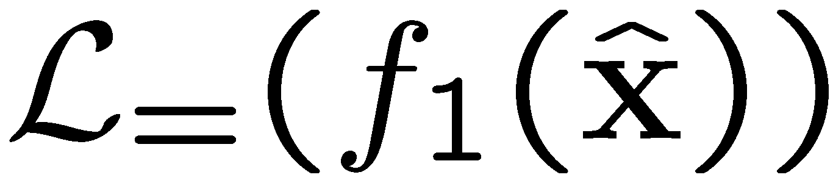

Finding Efficient Points by Level Sets: Example 1

Slide 23

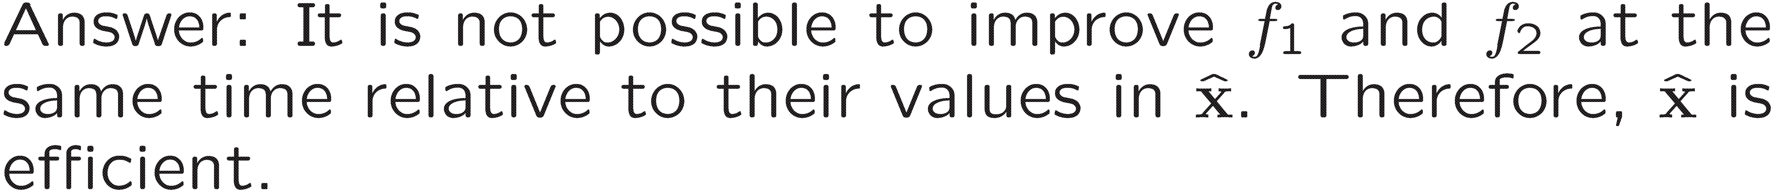
Finding Efficient Points by Level Sets: Example 2

Slide 24
Level Sets

Slide 25

Proof: Theorem on efficient points

